Slide 1
An I beacon based AI-Driven Wearable Surveillance System for Tracking and Intercepting Forced Human Transport
Project Supervisor: Presented By:
Dr. B. HEMALATHA. Polipalli Rajesh(U22EC348)
Professor, ECE Department, at Bharath University. Pulabala Sai Varun(U22EC361)
Ravula Vinay Kumar (U22EC367)
Project Coordinator:
Dr. G. SUDHAGAR.
Professor, ECE Department, at Bharath University.
)

Slide 2
ABSTRACT
Human trafficking and forced human transport remain critical global challenges due to the absence of reliable real‑time victim detection mechanisms, especially in GPS‑denied and phone‑restricted environments such as vehicles, containers, and isolated transit routes.
This project proposes an AI‑Driven Wearable Rescue Beacon System that automatically detects and signals potential forced transportation events using physiological and motion‑based intelligence.
The system integrates a MAX30102 heart rate sensor, MEMS accelerometer, iBeacon BLE module, Wi‑Fi connectivity, and an OLED‑based covert interface in a smartwatch‑form wearable.
The wearable continuously learns the user’s normal activity patterns and physiological beh Using sensor‑fusion and anomaly‑detection models, it identifies abnormal stress responses, sudden movement patterns, sustained vehicular vibration signatures, and loss of familiar beacon environments to infer potential abduction scenarios.

Slide 3
INTRODUCTION
In today’s world, women safety has become a major issue as they can’t step out of their house at any given time due to physical/sexual abuse and a fear of violence.
Even in the 21st century where the technology is rapidly growing and new gadgets were developed but still women’s and girls are facing problems.
Women are adept at mobilizing diverse groups for a common reason. They often work across ethnic, religious, political, and cultural divides to promote liberty. We are all aware of importance of women safety, but we must analyze that they should be properly protected. Women are not as physically fit as men, in an emergency situation a helping hand would be assistance for them.
The best way to curtail your probability of becoming a dupe of violent crime (robbery, sexual assault, rape, domestic violence) is to recognize, defence and look up resources to help you out of hazardous situation.
If you're in dilemma or get split from friends during a night out and don't know how to find back residence.
There are several app reduce the risk of sexual assault on women by informing control center and their associates through SMS, but in lay of those this apparatus have much more efficient way to inform those this respected personals and also has a defending system which cannot be provided by existing app.

Slide 4
LITERATURE SURVEY 1
A Survey on Women Safety Device Using IoT R. Ramachandiran ; L. Dhanya ; IEEE 2025.
In the Present day’s scenes women safety is considered to be the major problem in both urban and rural areas. It is quite difficult to change the mind-set of the entire society, but we can provide several security devices for the women who are facing sexual harassment, acid attacks, molestation, etc.
For providing the security, various smart devices and applications were developed.
Many smart devices and applications are also available in the market; But, it doesn't provide an effective solution. Experts from various field discovered women's safety device which works in both manually and automatically. This article examines various women safety related techniques.
The drawbacks and opportunities in women's safety devices are also discussed.

Slide 5
LITERATURE SURVEY 2
Design of a women safety device Divya Chitkara ; Nipun Sachdeva IEEE 2025.
Though there are unprecedented numbers of laws against domestic violence, sexual assault and other forms of violence in each and every country to protect their female citizens to become a victim of any such violence but they are facing major challenges in implementing such laws.
Thus making the society unjust and insecure for the women as in majority of cases the violator remains unpunished.
We all should focus on ensuring a society which is secure for all the women around the globe so that they can experience equality and justice.
In a sexual act of violence the aggressors are confident of the power they exercise. The defence strategy used by females needs to be revolutionised by adopting modern technology and gadgets to protect them from their oppressor. This device is an answer to all the women who deserve a safe and secure world.

Slide 6
LITERATURE SURVEY 3
The Personal Stun-A Smart Device For Women's Safety Shivani Ahir ; Smit Kapadia IEEE 2025.
Once the device is activated it starts sending the GPS location to the ICE contacts and police control rooms. There is a pulse rate sensor embedded in the device that senses the pulse rate of the person and a temperature senor that senses body temperature of the person.
The band when thrown with force the force sensor will get activated and sends the current location of the victim. A Piezo buzzer siren will get activated after 1-2 mins of the actual device getting turned on. The range of the buzzer is of 80-110 dB which can be heard from a distance of 50 feet long.
An electric shock circuit is designed that emits electric current. On the top of the band screen there are two metal points that generates the shock when the two metal points come in contact with any surface or anybody. The device supports a micro usb charging.
A smart application will be developed on the android platform which is connected with the device via bluetooth interface that shows the sensed data of the subject to the ICE contacts. Until the device is turned off it will send the location on the interval of 5 mins and will keep on beeping continuously.

Slide 7
LITERATURE SURVEY 4
A mobile application for Women's Safety: WoS App Dhruv Chand ; Sunil Nayak IEEE 2025.
The primary issue in the handling of these cases by the police lies in constraints preventing them from responding quickly to calls of distress.
These constraints include not knowing the location of the crime, and not knowing the crime is occurring at all: at the victim's end, reaching the police assuredly and discreetly is a challenge. To aid in the removal of these constraints, this paper introduces a mobile application called WoS App (Women's Safety App) that provides women with a reliable way to place an emergency call to the police.
The user can easily and discreetly trigger the calling function by shaking her phone, or by explicitly interacting with the user interface of the application via a simple press of a PANIC button on the screen.
A message containing the geographical location of the user, as well as contact details of a pre-selected list of emergency contacts, is immediately sent to the police. This paper describes the application, its development, and its technical implementation.

Slide 8
LITERATURE SURVEY 5
Integrating technology into the mission of a women's center: creating a women's community with technology L. Otterson ; D. Dufner IEEE 2025.
The Center now has a successful 4-year history of teaching women and girls to use technology, of using technology to leverage the resources and time of staff, and of using a listserv to disseminate information to the regional community.
Benefits gained from the integration of technology into the mission of the Women's Center include enabling the university's female staff and students to learn the Web and other computer related skills in a non-threatening woman-centered environment; providing information to geographically dispersed women; and easy access of the Coordinating Council to the director.
The Central Illinois Women's Action (CIWA) listserv creates a community of networked women and enables the director to participate in all the area's women community organizations.

Slide 9
EXISTING SYSTEM
Human trafficking detection mainly relies on CCTV and manual monitoring, which is ineffective in enclosed vehicles or isolated environments.
GPS tracking fails in indoor, underground, or metal-enclosed areas, making victims untraceable.
Emergency alert systems require manual activation, which is not possible if the victim is restrained or unconscious.
Most existing systems depend on smartphones, which may not be accessible during critical situations.
Current systems do not use physiological signals like heart rate or stress levels to detect danger.
iBeacon-based systems lack intelligence, secure alert transmission, and real-time detection capabilities.

Slide 10
EXISTING SYSTEM DISADVANATAGES
Not user friendly.
Cannot be implemented in all places.
Needs internet always.
Cost will be high.
Cannot detect abnormal conditions automatically
Does not monitor user’s physical or stress condition
Less reliable in critical or high-risk situations
Cannot detect abnormal conditions automatically
Less reliable in critical or high-risk situations
GPS tracking fails in indoor or closed environments

Slide 11
PROPOSED SYSTEM
AI-driven wearable Smartwatch integrates heart rate (MAX30102), MEMS accelerometer, and iBeacon BLE to monitor physiological and motion patterns continuously.
Learns the user’s normal activity and stress levels to detect abnormal patterns indicative of forced transport.
Automatically triggers silent rescue mode upon detecting potential abduction, without requiring manual activation.
Broadcasts encrypted IBeacon distress signals and uploads motion + biometric data to authorized receivers when network is available.
Enables real-time interception through BLE scanners at transit checkpoints, terminals, and patrol vehicles, ensuring covert victim protection even in GPS-denied environments.

Slide 12
PROPOSED SYSTEM ADVANTAGES
The solution is low-cost and can be implemented easily in real-life scenarios.
The system works automatically without requiring any manual activation during emergency situations.
It uses iBeacon technology to send silent alerts without alerting the attacker.
It provides continuous monitoring of the user’s condition and surroundings.
It uses iBeacon technology to send silent alerts without alerting the attacker.
It ensures privacy by sending secure and encrypted distress signals.

Slide 13
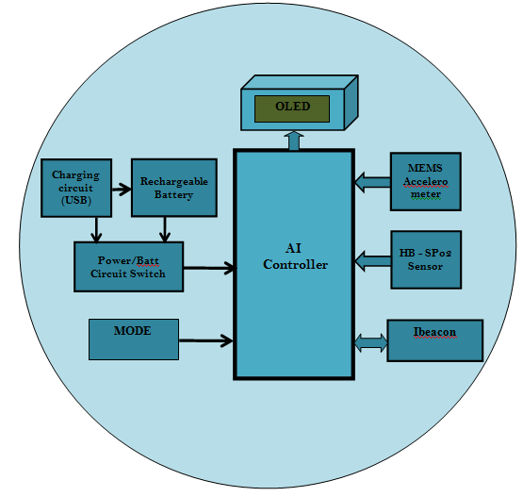
BLOCK DIAGRAM

Slide 14
HARDWARE USED
ESP32 Controller.
OLED display.
I2C board.
Heartbeat sensor.
MEMS detector.
Switch.
I beacon.
Power supply.

Slide 15
SOFTWARE USED
Programming Languages:
Embedded C
python
Integrated Development Environment (IDE):
Thonny IDE
Visual Studio

Slide 16
ESP32 MICROCONTROLLER
ESP32 is a microcontroller board based on the ATmega328P. It has 14 digital input/output pins (of which 6 can be used as PWM outputs), 6 analog inputs, a 16 MHz ceramic resonator (CSTCE16M0V53-R0), a USB connection, a power jack, an ICSP header and a reset button.
It contains everything needed to support the microcontroller; simply connect it to a computer with a USB cable or power it with a AC-to-DC adapter or battery to get started..
You can tinker with your Uno without worrying too much about doing something wrong, worst case scenario you can replace the chip for a few dollars and start over again.
"Uno" means one in Italian and was chosen to mark the release of Arduino Software (IDE) 1.0. The Uno board and version 1.0 of Arduino Software (IDE) were the reference versions of Arduino, now evolved to newer releases.
The Uno board is the first in a series of USB Arduino boards, and the reference model for the Arduino platform; for an extensive list of current, past or outdated boards see the Arduino index of boards.

Slide 17
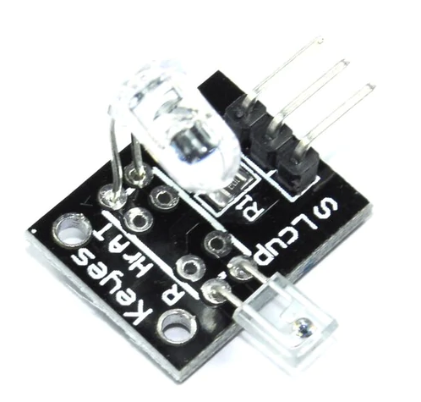
HEARTBEAT SENSOR
Heartbeat Sensor is an electronic device that is used to measure the heart rate i.e. speed of the heartbeat.
Monitoring body temperature, heart rate and blood pressure are the basic things that we do in order to keep us healthy.
Heart Rate can be monitored in two ways: one way is to manually check the pulse either at wrists or neck and the other way is to use a Heartbeat Sensor.

Slide 18
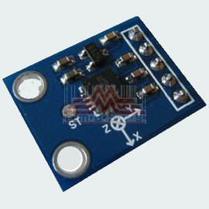
MEMS SENSOR
The term MEMS stands for micro-electro-mechanical systems.
These are a set of devices, and the characterization of these devices can be done by their tiny size & the designing mode.
The designing of these sensors can be done with the 1- 100-micrometer components.
These devices can differ from small structures to very difficult electromechanical systems with numerous moving elements beneath the control of incorporated micro-electronics.

Slide 19
IBEACON
iBeacon is a Bluetooth Low Energy (BLE) technology developed by Apple that allows mobile applications to detect and interact with physical beacons placed in the environment.
These beacons transmit signals that can be detected by compatible devices like smartphones and tablets within a specific proximity.
When a device enters the range of an iBeacon, it can trigger actions such as sending notifications, providing location-based services, or initiating app-specific tasks.
iBeacon are commonly used for proximity marketing, location tracking, asset management, and indoor navigation, offering businesses the ability to engage with users in real-time based on their physical location.
This technology is widely adopted in retail stores, museums, airports, and other venues for enhanced user experiences.

Slide 20
CONCLUSION
Our efforts behind the project are to set up and manufacture a small, self-contained component in itself, which benefits from a personal safety system, which is an immediate response system for women in crime incidents.
It is a low cost system that can keep records of specific members in a particular area and provide immediate caution in criminal cases against women.
This provides safety for women. Safety and security are the needs of the day.

Slide 21
APPLICATIONS
It helps in providing real-time alerts and improves emergency response systems.
It Can be used in school Students bag to monitor them.
It Can be implemented in vehicles for safety ride.
It can assist law enforcement agencies in tracking and preventing human trafficking cases.
It can be used as a wearable safety device for elderly people and vulnerable individuals.
It can be used in remote or GPS-denied environments for continuous safety monitoring.

Slide 22
REFERENCES
[1]. Simon L. Cotton and William G. Scanlon, “Millimeter - wave Soldier –to soldier communications for covert battlefield operation,” IEEE communication Magazine, October 2022.
[2]. Vamil B. Sangoi, “Smart security solutions,” International Journal of Current Engineering and Technology, Vol.4, No.5, Oct-2024.
[3]. B. Chougula, “Smart girls security system,” International Journal of Application or Innovation in Engineering & Management, Volume 3, Issue 4,April 2024.
[4]. Hock Beng Lim, “A Soldier Health Monitoring System for Military Applications,” International Conference on Body Sensor Networks.
[5]. Premkumar .P, Cibi Chakkaravarthi. R, Keerthana.M, Ravivarma.R, Sharmila. “One Touch Alarm System For Women’s safety Using GSM” International Journal of Science Technology & Management, 2025 March.
[6]. “SURAKSHA, A Device To Help Women In Distress: An Initiative By A Student of ITM University, Gurgaon”

